Slide 1
COVID-19 VACCINE SENTIMENT ANALYSIS USING TWITTER DATA

Slide 2

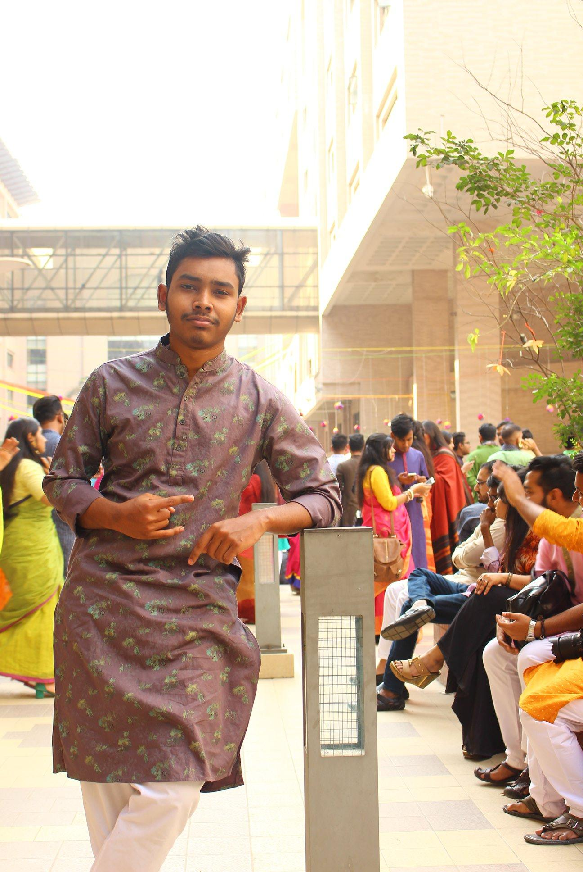
OUR TEAM
Kazi Nabiul Alam
Shakib Khan
Abdur Rab Dhruba
kazi.alam01@northsouth.edu
1711217642
shakib.khan17@northsouth.edu
1711661042
abdur.rab@northsouth.edu
1712441642

Slide 3
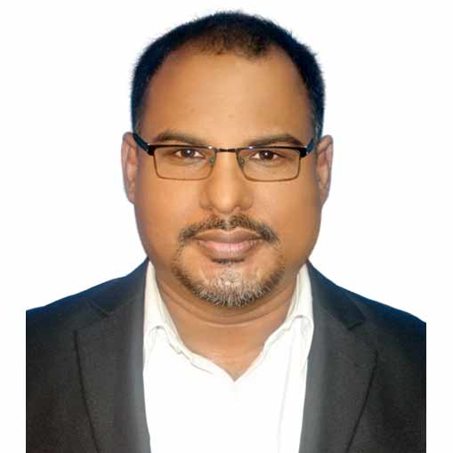
OUR SUPERVISOR
Mohammad Monirujjaman Khan, Ph.D
Department of Electrical and Computer Engineering North South University
Dhaka-1229, Bangladesh
E-mail: monirujjaman.khan@northsouth.edu

Slide 4
TABLE OF CONTENTS
01.
02.
03.
04.
05.
06.
07.
08.
Introduction
Research Background
Similar Research
Our Contribution
System Overview
Our Methodologies
Research outcomes
Future work & Conclusion

Slide 5
01.
INTRODUCTION
Covid19 & Covid19 Vaccination

Slide 6
VACCINES
SPUTNIK
PFIZER
ASTRAZENECA
MODERNA
COVAXIN
SINOPHARM

Slide 7
COVID-19 Impact & Vaccination
COVID-19 outbreak brought significant attention to the healthcare sector in recent times and it changed the entire concept of safety in every aspect of our lives. Social distancing is an effective method to reduce spreading Coronavirus, besides wearing masks, washing hands repeatedly, staying concerned about intimacy, such safety measures are very important these days. But these can only reduce spreading Coronavirus but can’t eradicate it completely, and here Vaccination came into broad light, the only parameter that can fight most effectively against SARS-CoV-2 and probably to kill it.
Rigorous tests have been conducted with the first mRNA-vaccines to be introduced; more than 40,000 people have participated in a Pfizer vaccine trial and 30,000 in the Moderna vaccine trial. The average efficacy rate of those who received vaccines was around 94 percent for prevention of COVID-19 disease. There were no deaths from the trials, and in both trials, the participants who received vaccines. Another viral vector vaccine i.e Johnson & Johnson, which proved to be able to fight against COVID-19 virus to stimulate the immune response of the recipient.

Slide 8
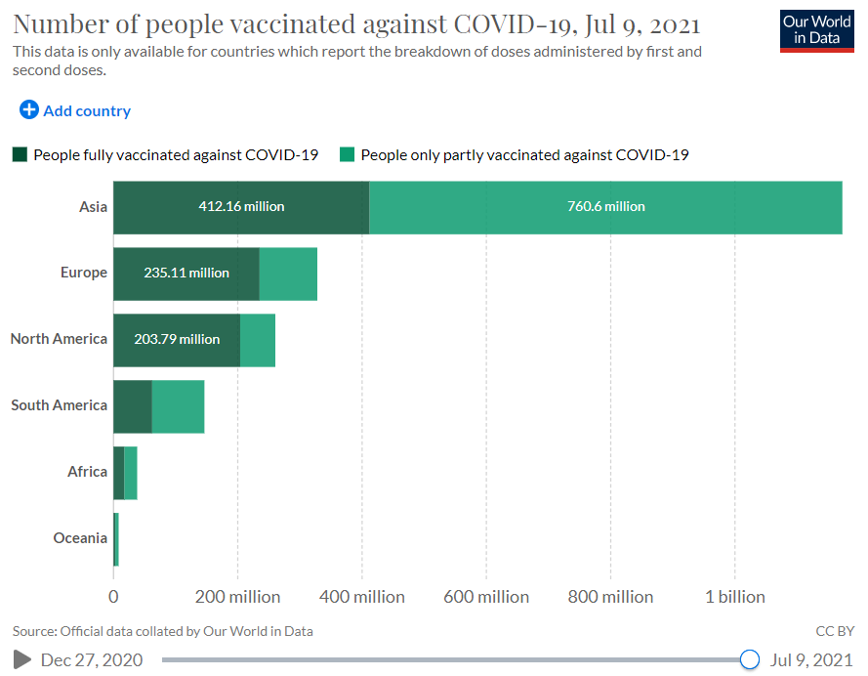
COVID-19 Impact & Vaccination
We observe that a large amount of the population are not vaccinated yet. We found out the lack of willingness and interest is also an alarming factor. People have mixed feelings in this whole vaccination process from the very beginning. Some scientific articles discussed what are the reasons that people are thinking more than twice to be vaccinated. Some reasons are: vaccines were invented so fast that there might not have been enough research on it, may cause cancer or infertility, concerns about people getting 2nd dose or not, allergic reactions, blood clotting, legitimacy of the production industry, political belief, religious issues, social media and online trends and some conspiracy theories.

Slide 9
02.
RESEARCH BACKGROUND

Slide 10
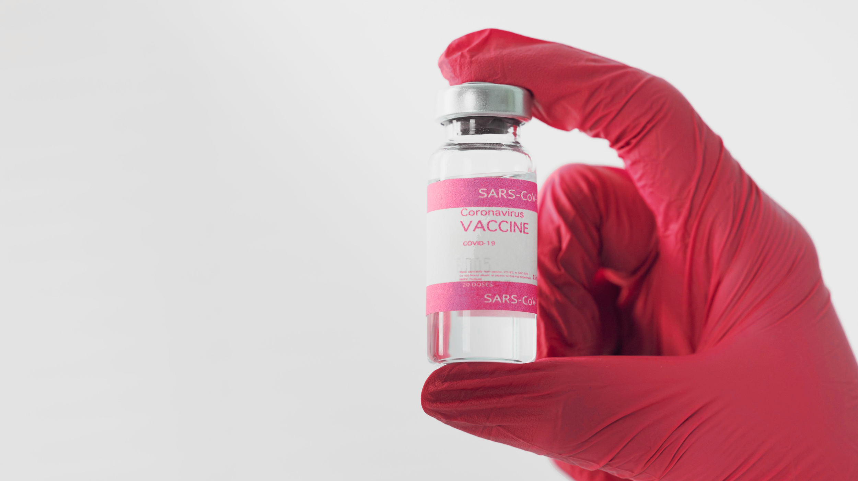
Research Background
we are observing that, some confusions or conflicts regarding the vaccination of COVID-19 among the mass people. Many people took decision to vaccinate themselves and a good number of people are still confused, many of them are frightened and many of them directly refused to be vaccinated. In our research, we’ve analyzed the sentiment of these people regarding the vaccination process. We used Deep Learning techniques to measure the basic stats about people whom are positive, whom are negative and whom are neutral in this vaccination procedure from the Covid-19 vaccination available datasets. We'd also theoretically analyzed the reason behind these conflicts or confusions.

Slide 11
03.
SIMILAR RESEARCH

Slide 12
Similar Research
01.
02.
Snscrape was used in the period from 7 January, 2020 to 3 January 2021 to collect the historical tweets for vaccination against COVID-19. In all, 4,552,652 Twitter posts have been pulled. These tweets were produced by 1,566,590 users, with 1,012,419 hashtags and 2,258,307 terms of reference. They used Valence Aware Dictionary and sEntiment Reasoner (VADER), a Python Lexicon and a rules-based sentiment analysis tool, which was developed to assess social media feelings on the basis of individual words and phrases, for assigning an amplitude of 'positive,' 'negative' or 'neutral' to each tweet. After extraction, they identified tweet vaccines and opinions and correlated their growth by period, geographic location, emerging topics, key phrases and postal engagement rate and reports. The prevalence of positive and negative feelings was slightly different with positive being the dominant direction and gaining large responses.
Another research we found relevant, performed on Australian people sentiment collected from Twitter. This analysis aimed at extracting important issues and sentiments on Twitter Topics relates to COVID-19 vaccination by using machine-learning methods. They focus in particular on three factors: COVID-19 and its vaccination attitudes, the advocacy of COVID-19 infection control measures and COVID-19 control misconceptions and complaints. Between January and October of 2020, they collected 31,100 English tweets from twitter users in Australian containing COVID-19-related keywords. In particular, tweets were analyzed by illustrating high frequency textual data clouds and interplay of word tokens. In order to identify the commonly mentioned subjects in a large tweet sample, they have created a Latent Dirichlet Allocation (LDA) model. Sentiment analysis was also performed to gain an idea of the overall feelings and emotions in Australia related to COVID-19.

Slide 13
04.
OUR CONTRIBUTION

Slide 14
Our Contribution
In our research, we tried to analyze the data of all the vaccines available such as: Pfizer/BioNTech, Moderna, Oxford/AstraZeneca, Covaxin, Sputnik V, Sinopharm, and Sinovac. We also focused on the timeline to such tweets for understanding sentiments, which we found novel and very important findings because sentiment is very much related and changeable with the flow of time, we also showed with text inputs that our system can detect the sentiment of a sentence properly or not. Our main goal of this research is to get a clear idea about the emotions and thoughts of the mass people regarding the vaccination process of COVID-19 we showed in later parts of this paper, that help the Health Researchers and Rule makers to take proper initiative to make these vaccines more unsuspicious and credulous, to keep the people safe and aware. In following sections, we showed the technical components we used and their outcomes with analytical tools. Section. 2 carries the methods and technical terminologies we used to analyze the sentiments. In section 3, we showed with proper visualization tools and description how these sentiments worked and what outcomes were found.

Slide 15
05.
SYSTEM OVERVIEW

Slide 16
Our System Overview
In this research, we collected a dataset from Kaggle and our dataset contains different types of tweets related to the covid-19 vaccine. Our dataset shape is (125906, 16). After loading the dataset we checked the unique values, Null values, and distribution of our dataset. Then we visualize data using user location, source, and user name. Next, for preprocessing, we used detokenize to break the sentences into words and label them. Next we calculate and add a sentiment column which contains (Positive , Negative , Neutral). Then we used LSTM and Bidirectional LSTM to evaluate the performance and we got good Accuracy. Then we tested our model and found they can detect which sentence is positive, negative, neutral almost accurately.

Slide 17
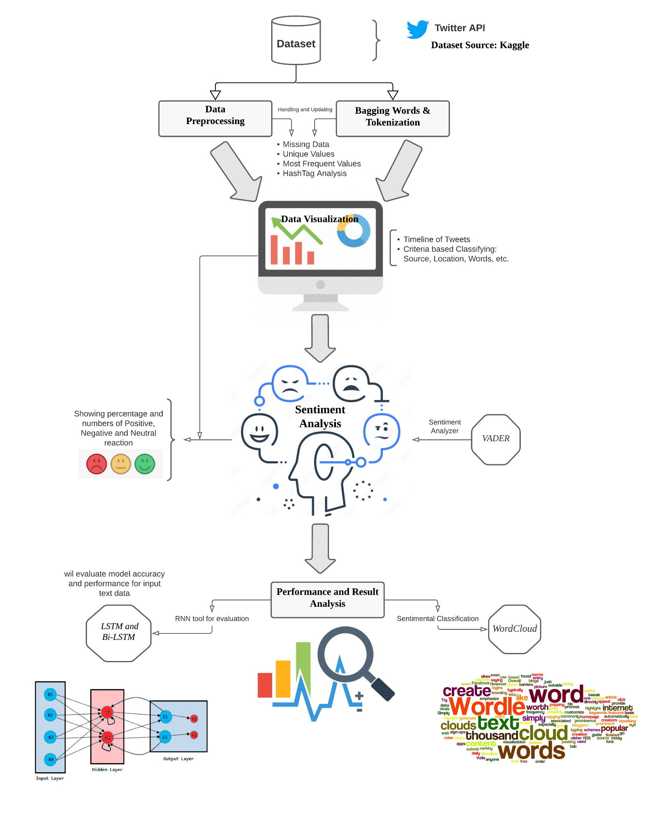
Our System
Architecture
According to our proposed methodologies mentioned above, we designed the full detailed outline of the system demonstrating in figure.
Fig- Outline of Sentiment Analysis procedures

Slide 18
06.
OUR METHODOLOGY

Slide 19
Dataset
There are various datasets available for COVID-19 reactions after it broke out all over the globe, but there are limited numbers of dataset we found for ‘Vaccination Reactions’ related to COVID-19. From them, we chose a dataset named ‘ All COVID-19 Vaccines Tweets’ from Kaggle where we found data of almost all the renowned vaccines such as: Pfizer/BioNTech, Oxford/AstraZeneca, Moderna, Covaxin, Sputnik V, Sinopharm, Sinovac, that are available and accepted to be implemented. Here, the dataset shape is (56585 by 16) that includes username, date, location, number of friends, retweets, hashtags, sources etc. Our motivation behind choosing this dataset is we found data of all the vaccines available currently and it helps us to generate precise and clear knowledge about vaccination reactions.
Kaggle Dataset:
https://www.kaggle.com/gpreda/all-covid19-vaccines-tweets

Slide 20
Data Preprocessing, Handling and Tokenization
We collected the dataset from kaggle, but the csv file didn’t have the process data. So we need to process it first before applying any algorithm. So,
First we dropped some unnecessary columns, then removed all the urls, emails from the tweets.
Then we took out all the new line characters, elementing all the double, single quotes , and deleted all the punctuation signs.
For this type of processing we first needed to tokenize all the tweets, then apply all the methods of removing those text.
After doing that we detokenize and converted them as a numpy array.
Furthermore, in this paper, each tweet is assigned a sentiment label as positive, neutral and negative using VADER which we added to our new process dataset.

Slide 21
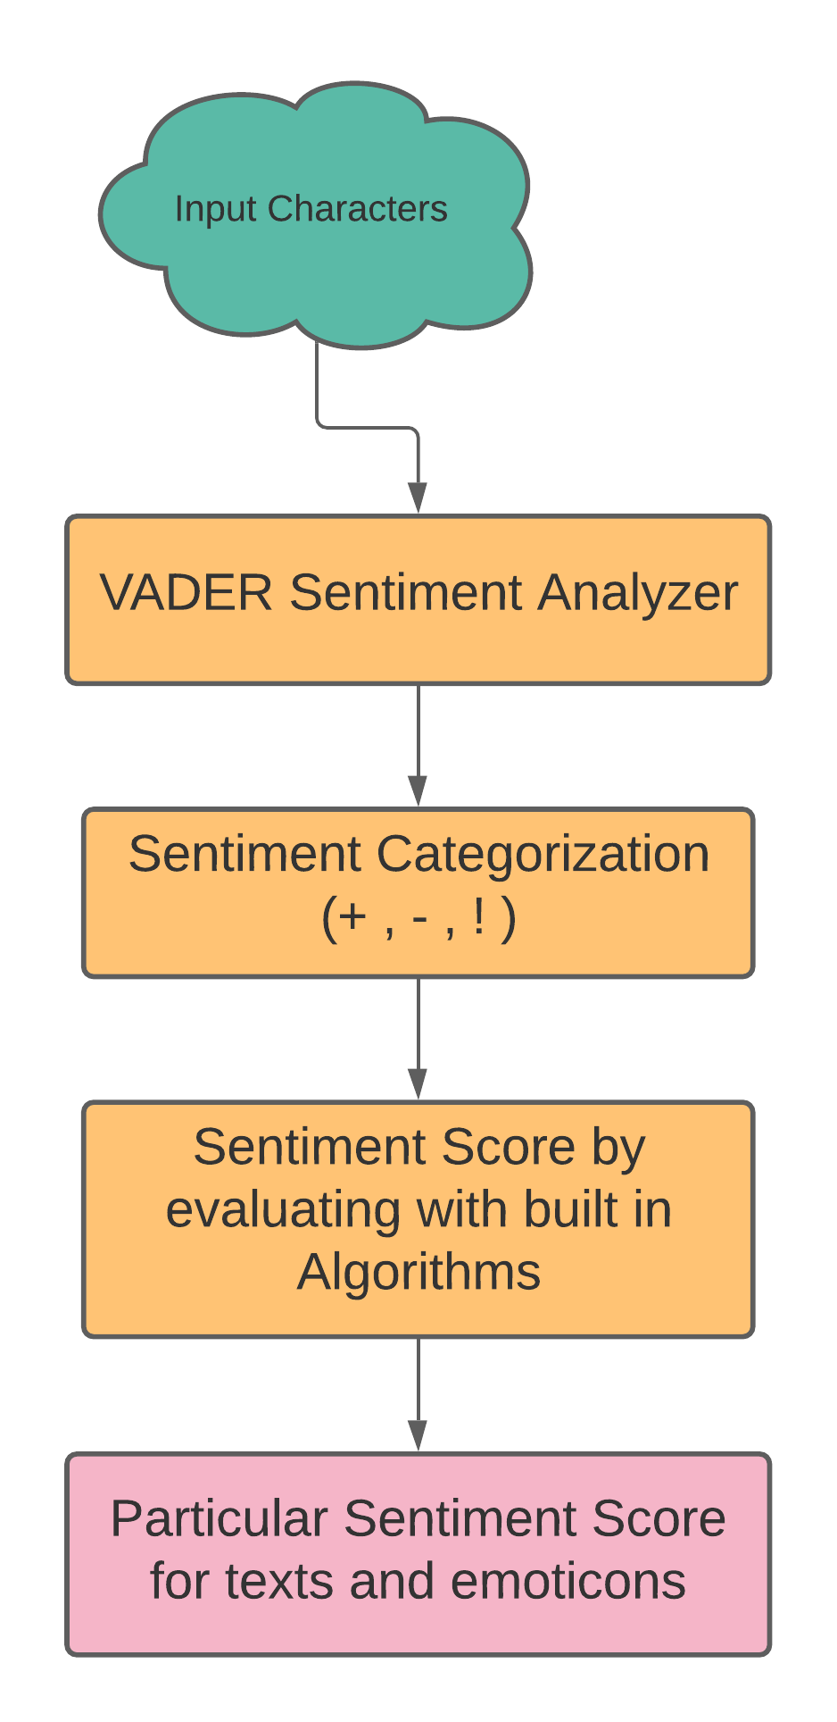
Sentiment Analyzer tool (VADER)
VADER (Valence Aware Dictionary for sEntiment Reasonable),is a lexicon based sentiment analyzer which is a pre-trained model that uses rules based values tailored to the perceptions of social media expressions and which works well on texts from other fields. It analyzes a message text and appraises the intensity of this emotion like: positive, negative and neutral. It is a polarity and reflectance Intelligent Dictionary available in the NLTK package. In particular, it has impeccable performance in the area of social media text. VADER can perform a sentimental analysis of assorted lexical characteristics based on its comprehensive rules, showed in Fig. VADER could therefore tackle the problems of indirect use of language groups and inherent action of sentiment.
Fig - Diagram of VADER

Slide 22
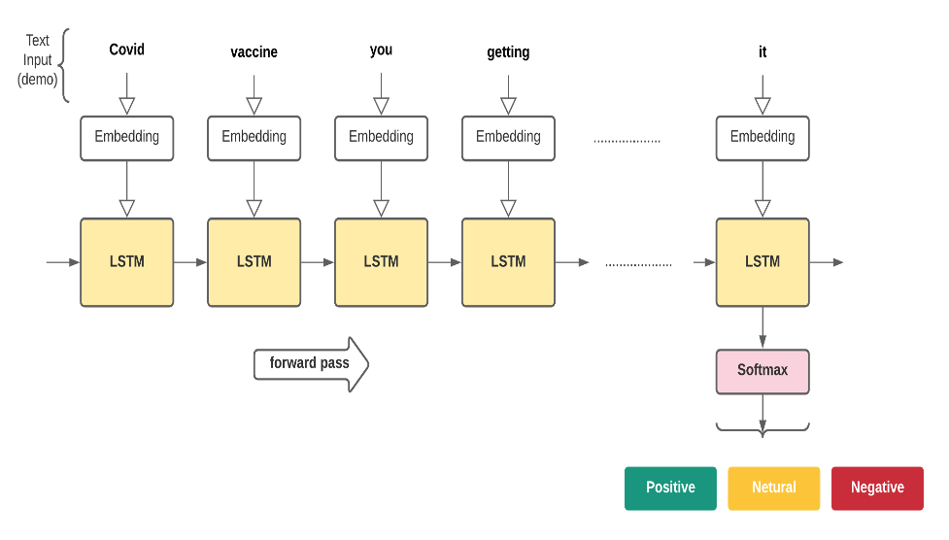
Proposed LSTM
An LSTM's control flow is similar to that of a recurrent neural network (RNN) showed in Fig. . As it moves forward, it processes data and passes it forward. The LSTM's cells have a variety of actions. These processes are used by the LSTM to recall or forget information. The four gates that make up the LSTM architecture are the input gate, forget gate, control gate, and output gate.
Figure: LSTM Architecture for proposed tasks

Slide 23
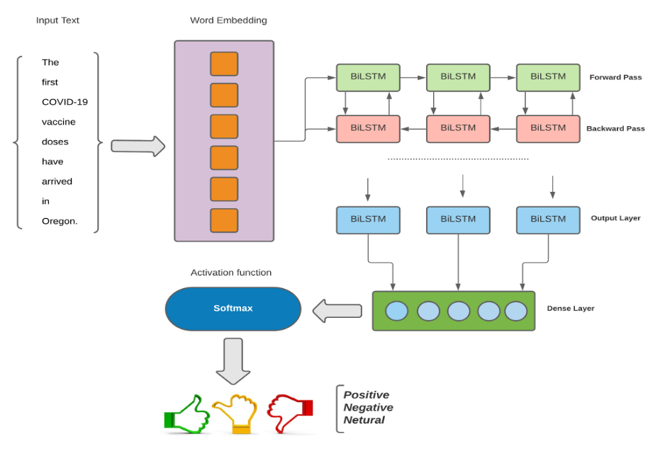
Proposed Bi-LSTM
The idea of Bi-LSTMs comes from bidirectional RNN , which analyzes sequence input in both forward and backward directions with two different hidden layers, and is the inspiration for BDLSTMs. The two hidden layers are connected by BDLSTMs to the same output layer. In various disciplines, such as phoneme classification and speech recognition,bidirectional networks have been shown to outperform unidirectional networks.
Figure: Bi-LSTM Architecture for proposed tasks

Slide 24
07.
RESEARCH OUTCOMES

Slide 25
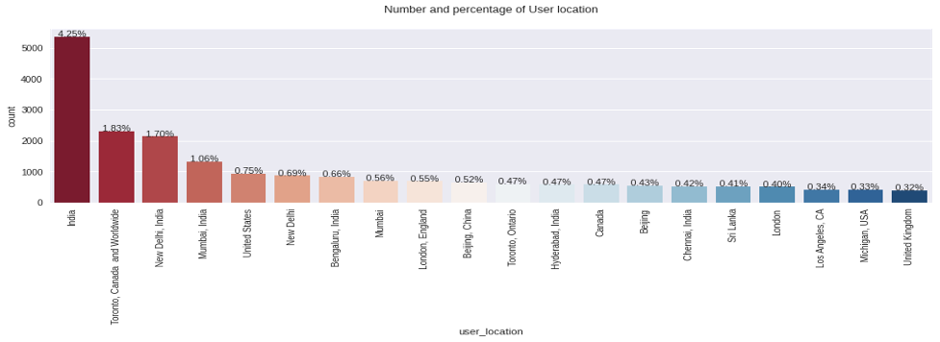
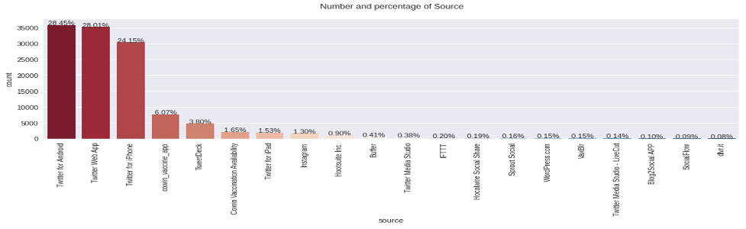
Tweets according to user locations and sources
we showed the sources of such vaccine reactions and we found out twitter was the most used platform for delivering these thoughts in COVID-19 situation. And as our data contains tweets from all around the world, we tried to show in Fig some major regions where tweets came from.
Figure: Sources of vaccine reactions
Figure: User Location of tweets

Slide 26
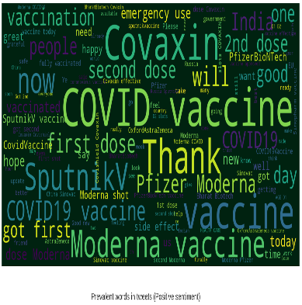
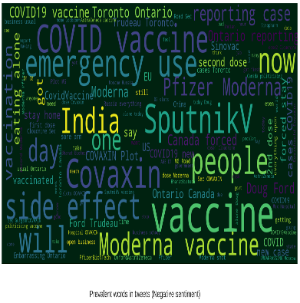
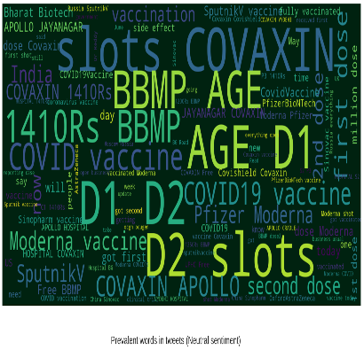
Country wise ‘Prevalent Word’ usage
Using text cloud, the specific words or terms are classified in 3 polarity groups are shown
Figure: Words according to Positive
Figure: Words according to Negative
Figure: Words according to Neutral

Slide 27
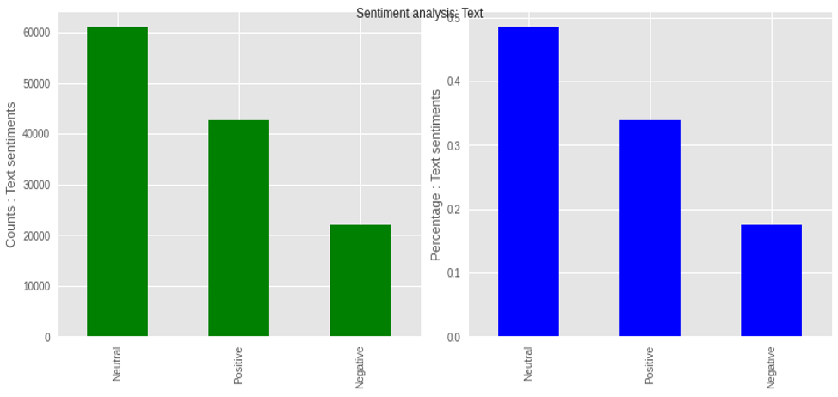
Numbers and Percentage of Sentiment criteria
We demonstrated the numbers of tweets classified as Positive, Negative, And Neutral by Green bar charts and percentages of these 3 categories with Blue bar charts. For the charts colored Green, x-axis determined the the numbers of tweets and y-axis determined the sentiment classes. And in Blue charts, probability distributions are shown in x-axis and in the sentiment classes in y-axis.
Figure: Numbers and Percentages of Sentiment criteria

Slide 28
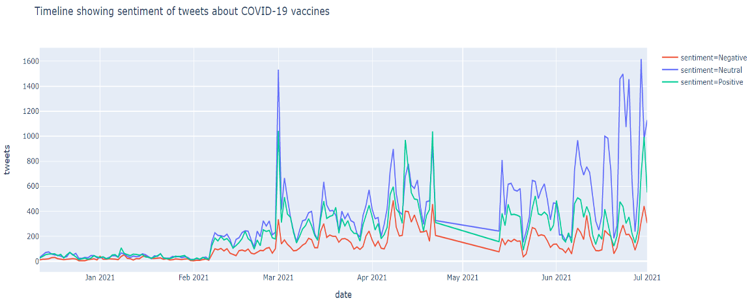
Timeline of these sentiments
As we said earlier, sentiment or emotions evolve and transform with the time period. In this research we showed how the reactions changed with the time and how it’s fluctuated in different time intervals. We showed in Fig. 17 how sentiment changes or shuffles with the time went by. 3 sentiment classes are shown in 3 colors. For positive, negative and neutral the colors we used are green, red and blue respectively
Figure: Sentiment variation with Time

Slide 29
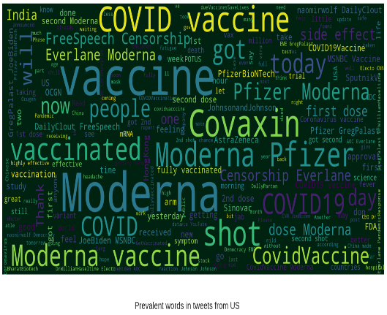
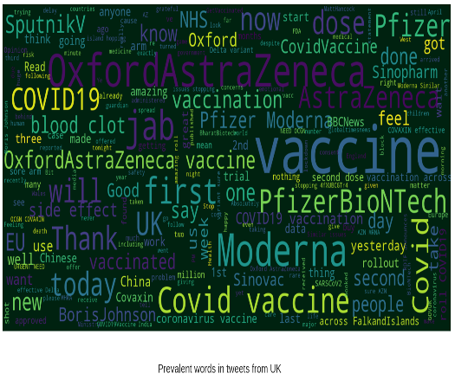
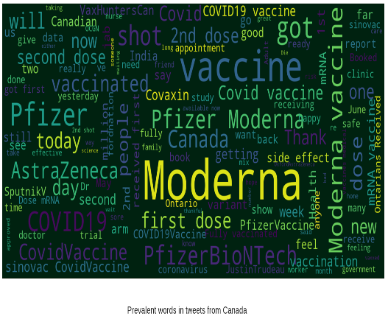
Sentiment words according to polarities
Here in collecting major utterances of vaccine related sentiments, we prioritize the users who have most of the tweets according to the location. So using word cloud we visualized the terms that were most used in the USA, UK, Canada and India respectively in Figures to have a clear concept of the overall scenario.
Figure: Terms used most in US
Figure: Terms used most in UK
Figure: Terms used most in Canada

Slide 30
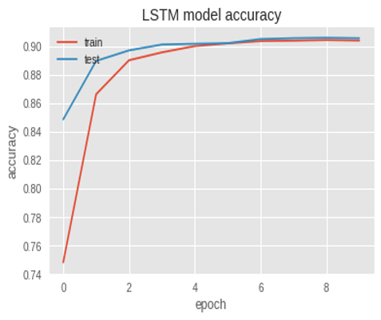
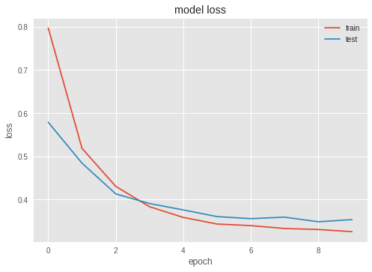
LSTM Model Accuracy & Loss
In the LSTM model, we get accuracy about 90.59%
Figure: LSTM Accuracy & Loss

Slide 31
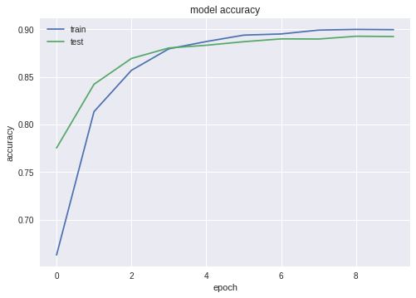
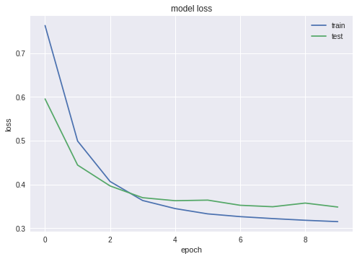
Bi-LSTM Model Accuracy & Loss
In the Bi-LSTM model, we get accuracy about 90.83%
Figure: Bi-LSTM Accuracy & Loss

Slide 32
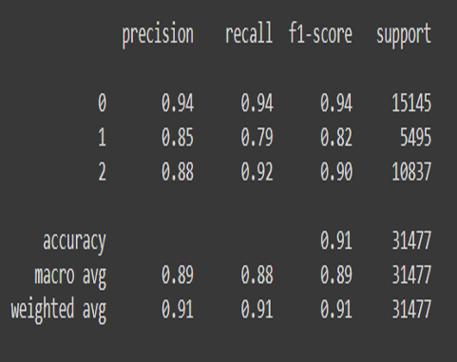
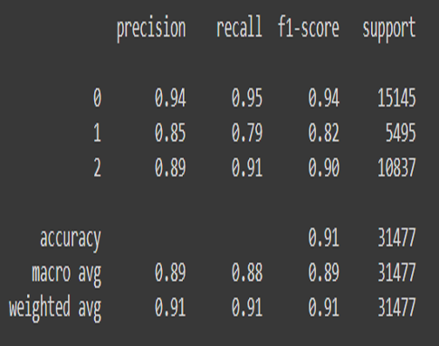
Performance metrics
We also showed some more performance analysis, below we showed some performance classification metrics like: Precision, Recall, and F-1 score for both models.
Figure: Performance metrics for LSTM
Figure: Performance metrics for Bi-LSTM

Slide 33
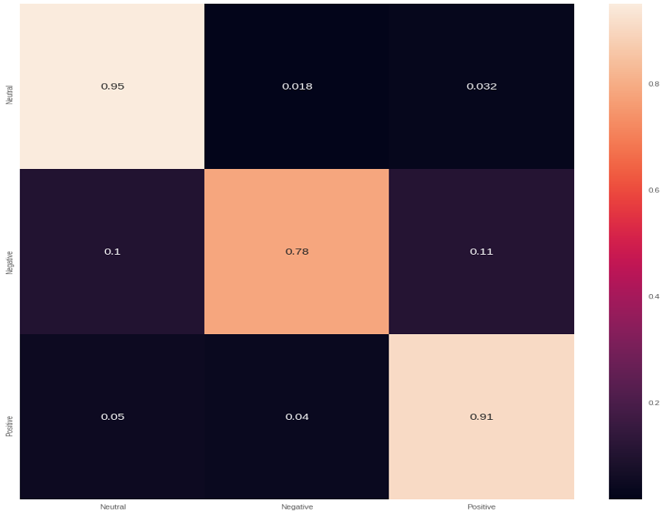
Confusion Matrix
Figure: Confusion Matrix for Sentiments

Slide 34
08.
FUTURE WORK & CONCLUSION

Slide 35
Future work & Conclusion
This research will help the health researchers to get the proper knowledge of the issues regarding the vaccination process. The companies who produce vaccines, Governments or Health Ministries of different countries, or policy makers of this sector like WHO or others, can have proper idea about whether their vaccine is effective or not, and the percentage of this effectiveness as well. They can understand that, in which sector, they have to improve, so that people can have faith in this vaccination process. Moreover, they may have a clear idea about how many doses they should be ready with according to the wishes of the mass people. In Health Science Research, our project will be an added benefit to find out the proper scenario and pros & cons of the vaccination process of Covid-19. We believe we'll be a little but effective part to help the upfront fighters against these NOVEL Coronavirus and keep our lives healthy and safe.

Slide 36
T H A N K S !

